Slide 1
TencentOS-Tiny Software Pack based on MDK development
Tutor: WANG Lichao
Developer: CUI Linwei

Slide 2
01
01
Research Background
02
02
Design solutions
03
Content
03
Content design
04
04
Software pack testing
05
05
Summary and outlook

Slide 3

Research Background

Slide 4
Software pack creation requirements
TencentOS-tiny
User Development
TencentOS tiny is a real-time operating system developed by Tencent for the Internet of Things. It features low power consumption, low resource consumption, modularity and scalability, and can be flexibly ported to a variety of terminal MCUs.
Different companies have different microcontroller kernels, users need to choose different porting files when porting TencentOS tiny.
In order to reduce developers' porting time and improve the efficiency of porting under different ARM cores, the third-party TencentOS Tiny pack is completed based on MDK, enabling the use of MDK pack to directly generate TencentOS Tiny projects for different MCUs.
Notes:
TencentOS tiny is a real-time operating system developed by Tencent for the Internet of Things (IoT) field, which has many advantages.
However, when users are developing and porting, they need to select files that are suitable for the kernel because the kernels of different manufacturers' chips are different.Therefore, in order to reduce development time and improve efficiency, it is necessary to complete the packaging of TencentOS tiny packages, so as to directly generate porting projects suitable for different users.

Slide 5
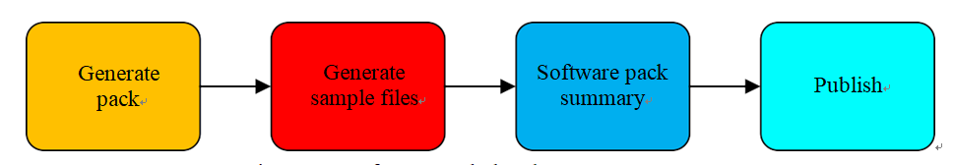
Introduction to ARM pack
Types
1、Device family pack
2、Board level support pack
3、CMSIS pack
4、Middleware pack
5、Internal components
Advantages
1. increase in productivity.
2. increased flexibility.
3. simplified maintenance
of long-term projects.
Production process:
Notes:
ARM provides us with five software packages that
Device family packages: generated by the silicon supplier or tool supplier
(2) Board level support packages: published by the board supplier
(3) CMSIS packages: provided by ARM, including support for the CMSIS core, DSP and RTOS
(4) Middleware packages: created by chip vendors, tool vendors or third parties; reduces development time by providing software integration of commonly used software components.
(5) Internal components: developed by tool users for internal or external distribution.
Increased productivity: rapid selection of components to enable migration.
Increased flexibility: the ability to add third-party software packages at will to support project development.
Simplification of long-term project maintenance: product iterations can be completed by updating package versions.
Writing PDSC wrapper files and using scripts to generate packages

Slide 6

Design solutions

Slide 7
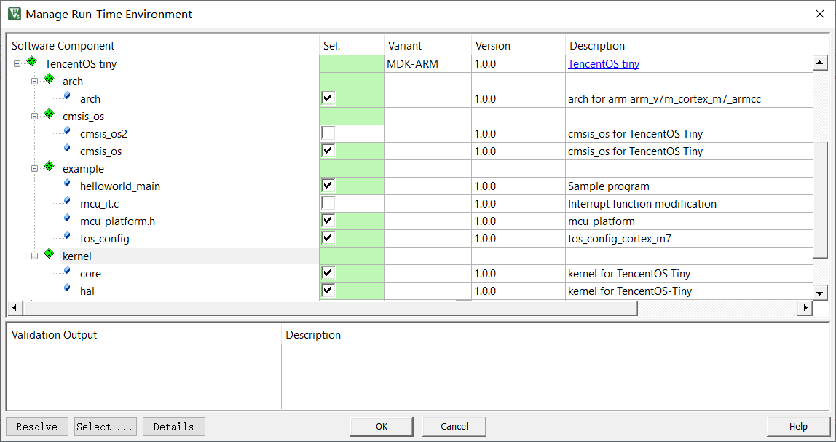
TencentOS-Tiny Software Pack based on MDK development
Based on the XML format language to write PDSC files, complete the package of TencentOS-Tiny files, and design dependencies for various cores such as ARM Cortex-M0+, M0, M3, M4, M7, M23, M33, etc., adapt the user's cores to provide arch files, and provide sample files for users, so that users can quickly port TencentOS-Tiny to various cores of microcontrollers.
Notes:
The next step is to introduce the package design. When porting TencentOS-Tiny to keil, the arch, kernel, cmsis_os and tos_config files need to be ported, so the package needs to contain these, and we should also provide the user with some example files that can be easily modified, these files can be wrapped in PDSC files The following is the user interface of the package, including the arch, cmsis_os, examples and kernel branches

Slide 8
Software pack architecture
Contents |  | Functions
arch |  | Includes arch files for cores Cortex-M0+, Cortex-M0, Cortex-M3, Cortex-M4, Cortex-M7, Cortex-M23, Cortex-M33 under TencentOS-tiny\arch\arm
kernel |  | Include kernel files in the core, hal, and pm paths under TencentOS-tiny\kernel, and tos_config files under TencentOS-tiny\board, crop function
cmsis_os |  | cmsis_os in TencentOS-tiny\osal\cmsis_os
example | helloworld_main | The main file for testing the pack
 | mcu_it.c | For making changes to interrupt function
 | mcu_platform.h | Add header files for external microcontrollers and chips here
Notes:
arch: M-kernel interrupts, assembly scheduling, tick-related code
Kernel: kernel, tos_config file
cmsis_os: system packaging interface layer
example: user-friendly main file for testing, interrupt modification function, user's peripheral header file, this part can be modified by the user, the previous parts cannot be modified by the user

Slide 9

Content design

Slide 10
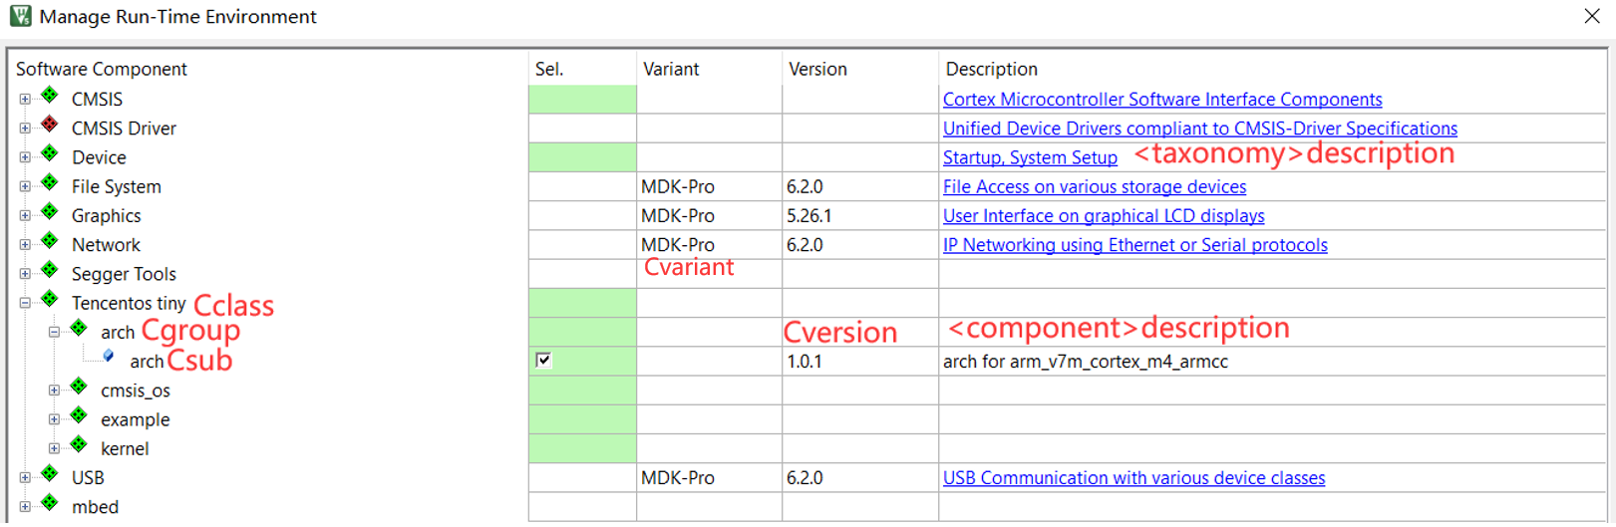
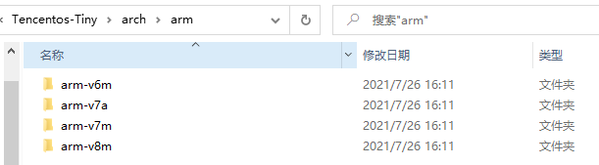
Pack Contents: 1、arch
Encapsulated arch files for the cores Cortex-M0+, Cortex-M0, Cortex-M3, Cortex-M4, Cortex-M7, Cortex-M23, Cortex-M33 under TencentOS-tiny\arch\arm.
Dvender tags and Name tags for different ARM kernels as separate conditions for the adaptation of arch files to the kernel
<condition id="Cortex_M0+">
<accept Dvendor="ARM:82" Dname="ARMCM0P*"/>
<condition id="Cortex_M0">
<accept Dvendor="ARM:82" Dname="ARMCM0"/>
<condition id="Cortex_M3">
<accept Dvendor="ARM:82" Dname="ARMCM3"/>
<condition id="Cortex_M23">
<accept Dvendor="ARM:82" Dname="ARMCM23*"/>
Notes:
Arch files include arm header files for different kernels, assembly scheduling files, etc. In order to adapt arch to different kernels, the Csub corresponding to each kernel file is named arch and matched with arch according to the Dvender and Dname design conditions of the kernel or chip, and the corresponding file is automatically displayed when the user selects that chip or kernel.

Slide 11
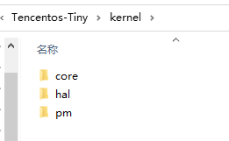
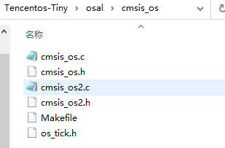
Pack Contents: 2、kernel、cmsis_os
Wraps the TencentOS-tiny kernel files under TencentOS-tiny\kernel and the tos_config file for trimming TencentOS-tiny functions, as well as the TencentOS-tiny\osal\cmsis_os and cmsis_2 files for users to use.
In the package design, the kernel file and the tos_config file are mandatory and the cmsis is user-selectable.
Notes:
Cmsis_os and kernel are files provided directly by the package, with the kernel file and tos_config file being mandatory and cmsis being user-selectable.

Slide 12
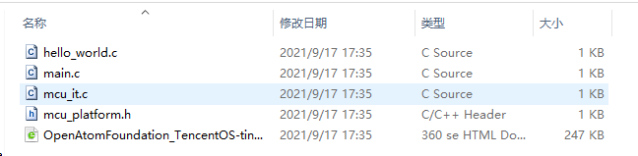
Pack Contents: 3、example
The example includes the main file for user testing (helloworld_main), the interrupt modification file (mcu_it.c), the user's peripheral header file (mcu_platform.h) and the Github page for TencentOS tiny.
Notes:
The example includes the main file for user testing (helloworld_main), the interrupt modification file (mcu_it.c), and the user's peripheral header file (mcu_platform.h).

Slide 13
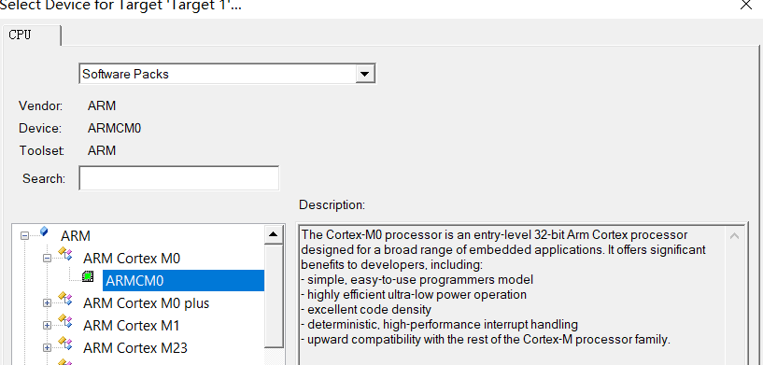
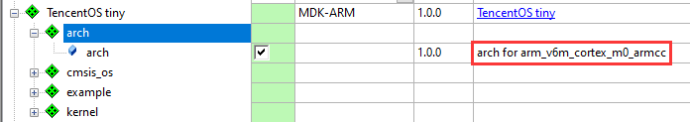
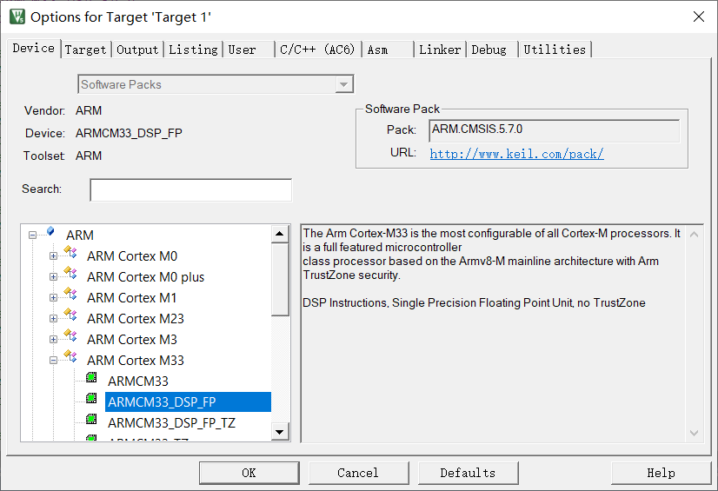
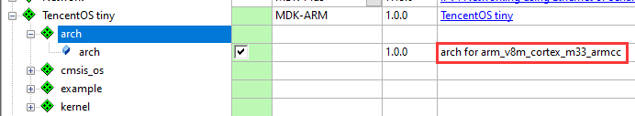
Pack functions: 1. Adaptation to ARM cores, core-based chips
Adaptable to ARM Cortex-M0+, M0, M3, M4, M7, M23, M33 and other cores, with corresponding arch files
Notes:
The next section describes the functions implemented in the package, starting with the kernel and chip adaptation functions, as shown in the diagram, which provide different arch and tos_config files for different kernel selections

Slide 14
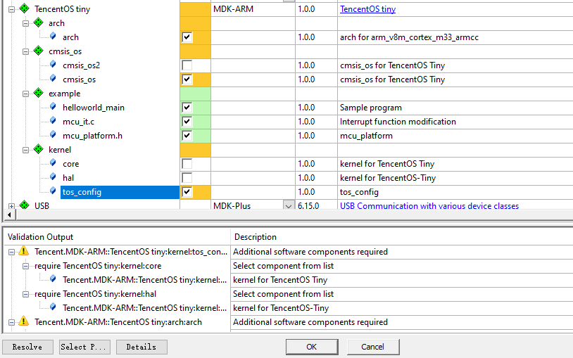
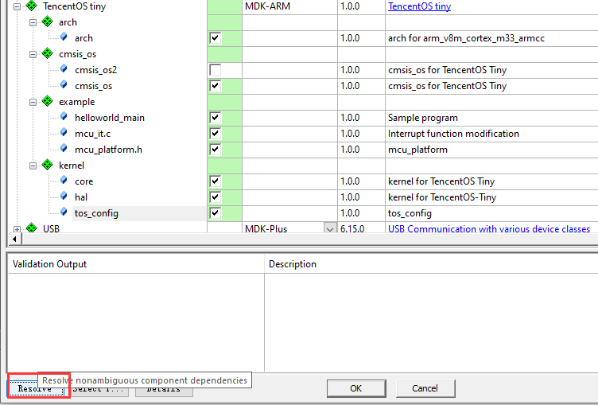
Pack functions: 2. Component tick reminder and one-click ticking
When selecting components, the package will automatically remind the user of the components that still need to be selected, and the user can either click to install them one by one, or use resolve to install them in one click.
Notes:
Then there are component reminders, when the user selects a component, the package will automatically remind the user of the components that still need to be selected, the user can click to install them one by one or use resolve to install them in one click.

Slide 15
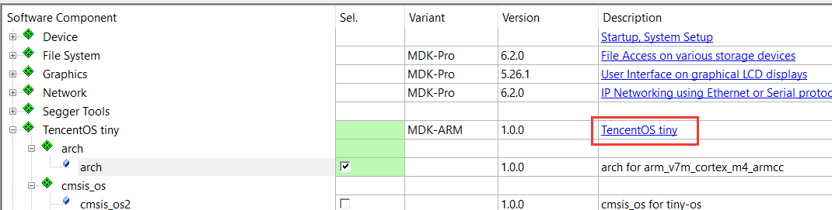
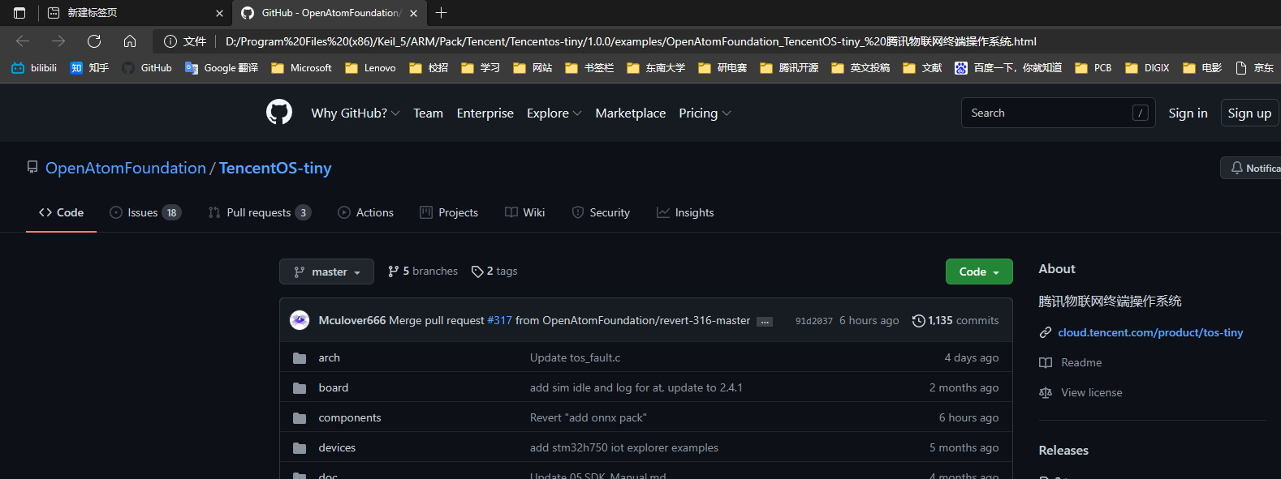
Pack functions: 3. Web jumping function
After installing the package, users can click on TencentOS Tiny in the picture to jump to the TencentOS-Tiny webpage.
Notes:
After installing the package, click on TencentOS Tiny in the picture to be redirected to the TencentOS-Tiny webpage.

Slide 16
Pack functions: 4. Extension development function
(1) Kernel adaptation
extensions
<condition id="Cortex_M0">
<accept Dvendor="ARM:82" Dname="ARMCM0"/>
<accept Dvendor="STMicroelectronics:13" Dname="STM32F0*"/>
</condition>
<condition id="Cortex_M0+">
<accept Dvendor="ARM:82" Dname="ARMCM0P*"/>
<accept Dvendor="STMicroelectronics:13" Dname="STM32G0*"/>
</condition>
<condition id="Cortex_M3">
<accept Dvendor="ARM:82" Dname="ARMCM3"/>
<accept Dvendor="STMicroelectronics:13" Dname="STM32F1*"/>
<accept Dvendor="GigaDevice:123" Dfamily="GD32F1x0 Series"/>
</condition>
<condition id="Cortex_M4">
<accept Dvendor="ARM:82" Dname="ARMCM4*"/>
</condition>
<condition id="Cortex_M7">
<accept Dvendor="ARM:82" Dname="ARMCM7*"/>
</condition>
<condition id="Cortex_M23">
<accept Dvendor="ARM:82" Dname="ARMCM23*"/>
</condition>
<condition id="Cortex_M33">
<accept Dvendor="ARM:82" Dname="ARMCM33*"/>
</condition>
Adaptation to different cores and chips
Notes:
Finally there is the package extension development function. In the future, if you need to make the package include new kernels or vendor's chips, you can simply change the Dvender, Dname or Dfamily in the PDSC file.

Slide 17
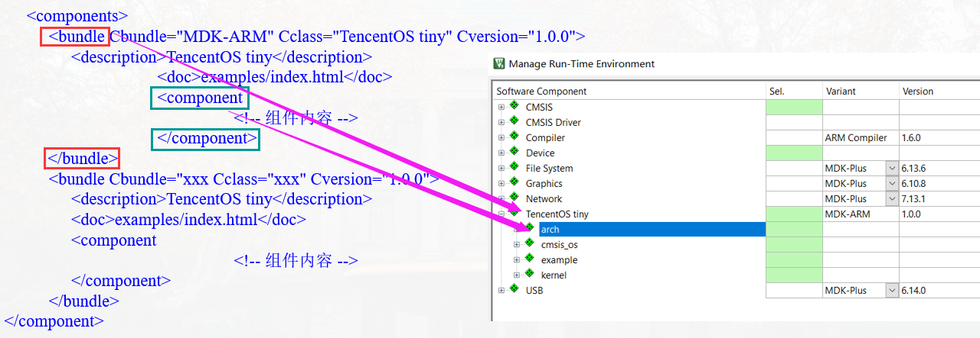
Pack functions: 4. Extension development function
(2) Package extension development
Notes:
When designing the PDSC file, bundle tags are used, and a package can be designed under each bundle tag so that if other functional packages for TencentOS tiny are subsequently released, they can be distinguished from the existing ones and displayed outside of it.

Slide 18

Software pack testing

Slide 19

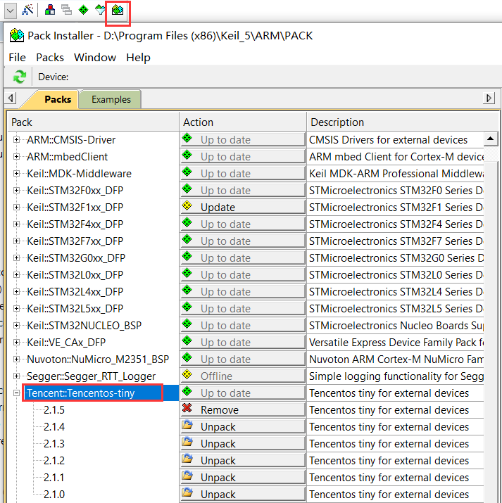
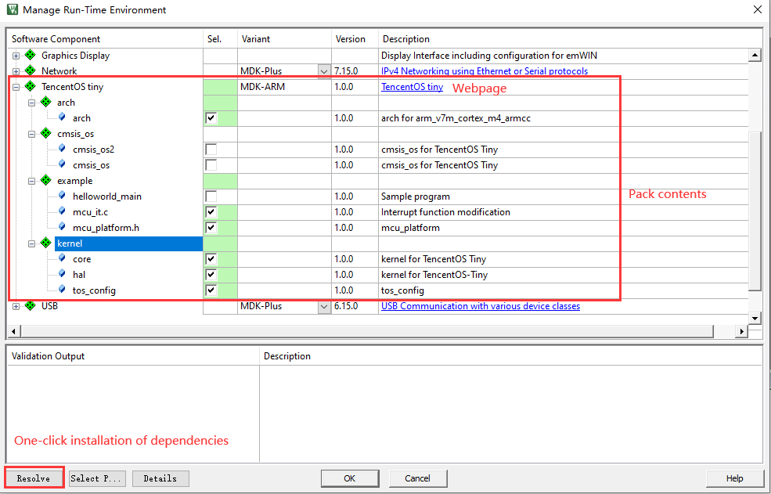
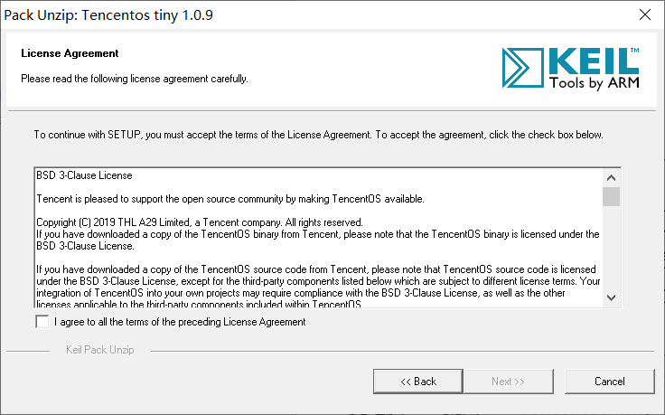
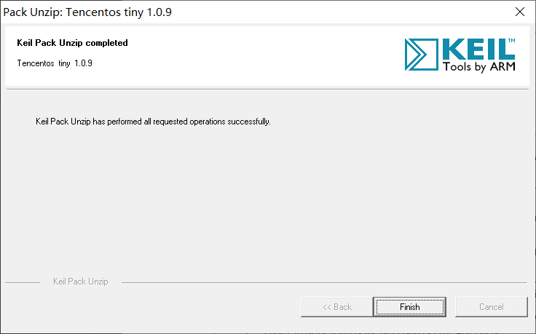
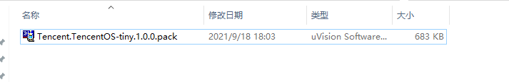
1. Pack installation
After double-clicking on the package to install it, you need to agree to the BSD 3-Clause License
Notes:
After double clicking on the package to install it, you need to agree to the BSD 3-Clause License.
On the left you can modify the version, on the right you can view the contents

Slide 20
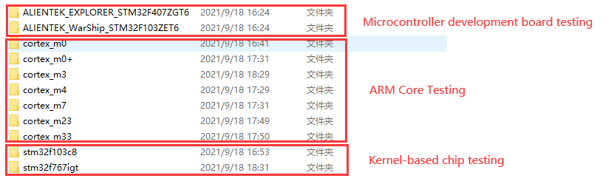
2. TencentOS-tiny pack testing
After installing the package, the following tests were carried out:
Test software versions: MDK-ARM Version 5.14, 5.30, 5.35.
Tests on: ARM cores (Cortex M0, M0+, M3, M4, M7, M23, M33), chips based on ARM cores (STM32F103, STM32F767), microcontroller development boards (Alientek Warship, Explorer) in three areas.
Test results: the software packages were all quickly ported and compiled.
Notes:
After designing the package, three versions of keil 5.14, 5.30 and 5.35 were carried out and tested on Cortex M0, 0+, 3, 4, 7, 23 and 33, the kernel-based chips stm32f103c8,stm32f767, the microcontroller Positive Point Atomic Explorer and Battleship, the packages were all quickly ported and compiled and passed, while the packages were The packages were sent to the official TencentOS tiny technical exchange group for testing.

Slide 21
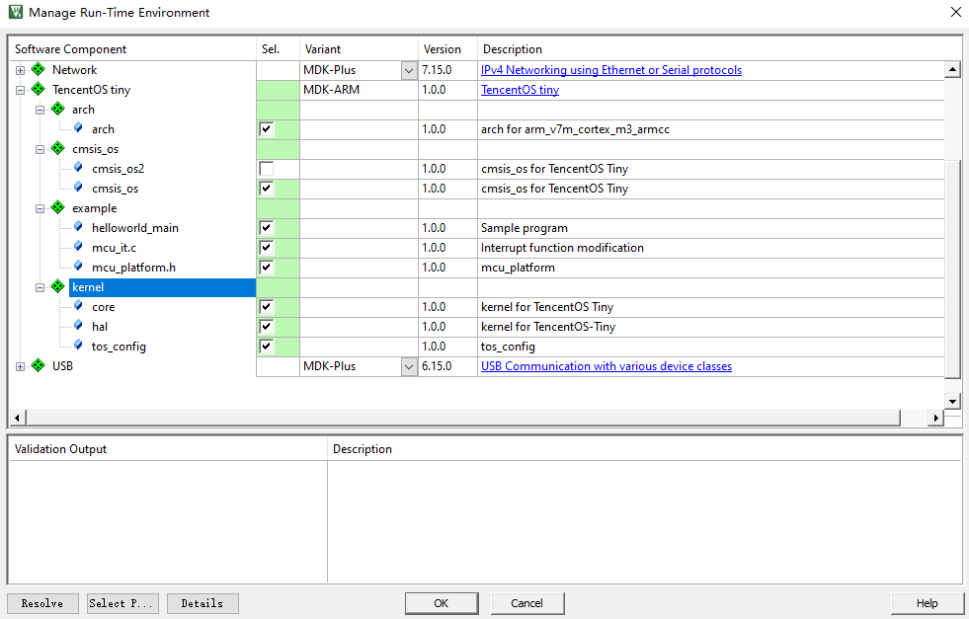
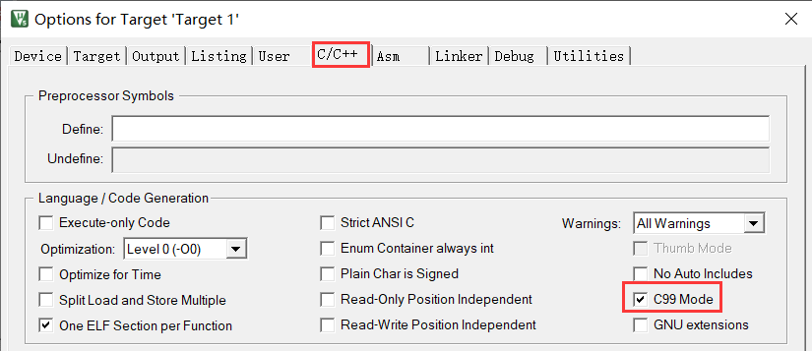
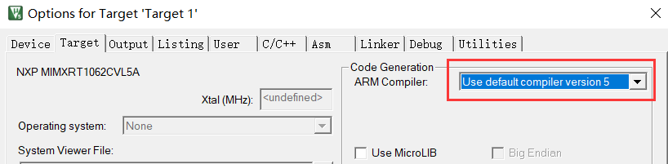
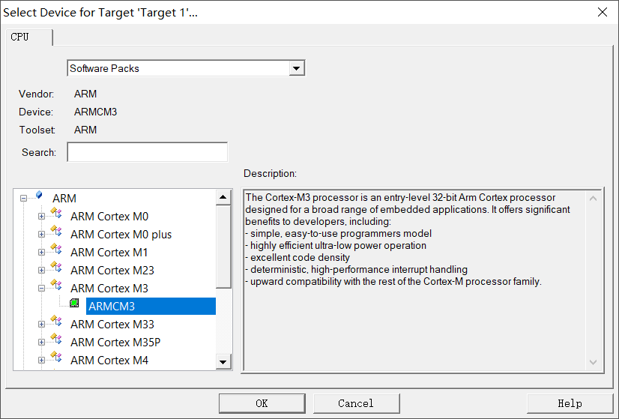
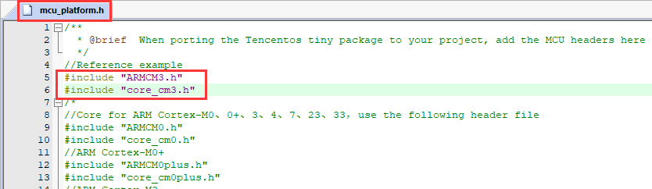
2.1. ARM core Cortex-M3 porting pack

Slide 22
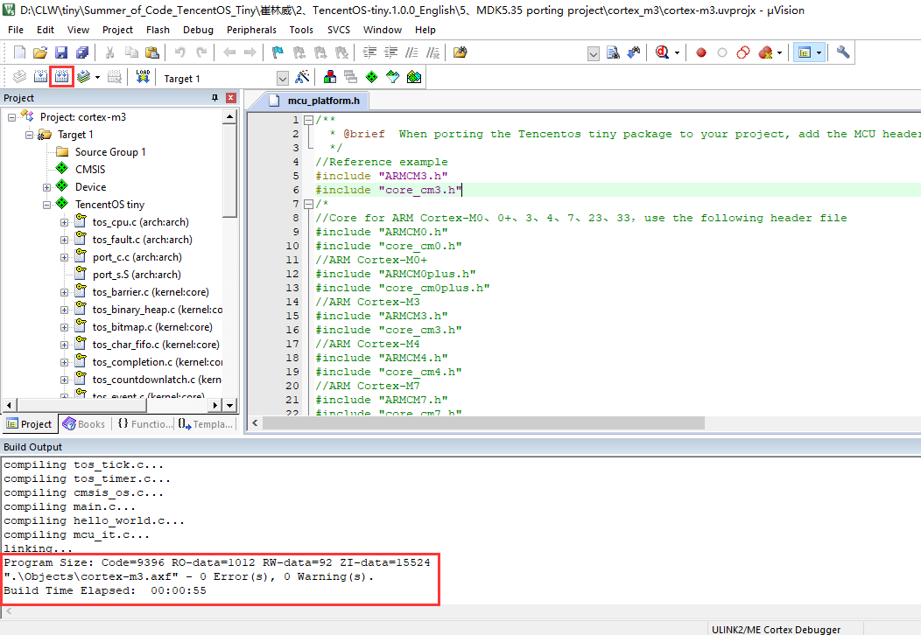
2.1. ARM core Cortex-M3 porting pack

Slide 23
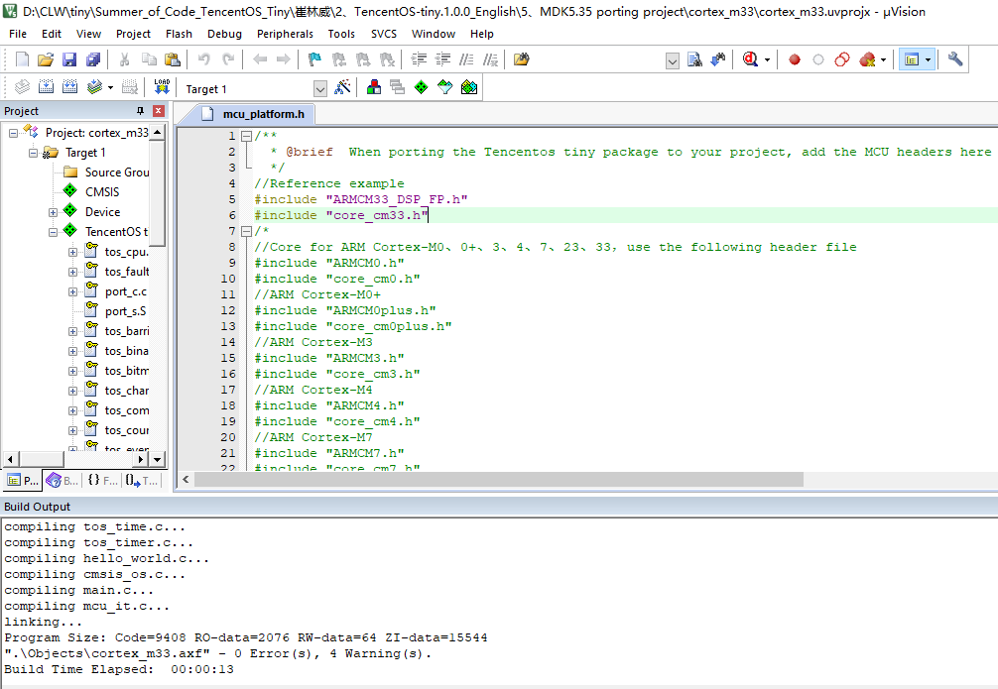
2.2. ARM core Cortex-M33 porting pack

Slide 24
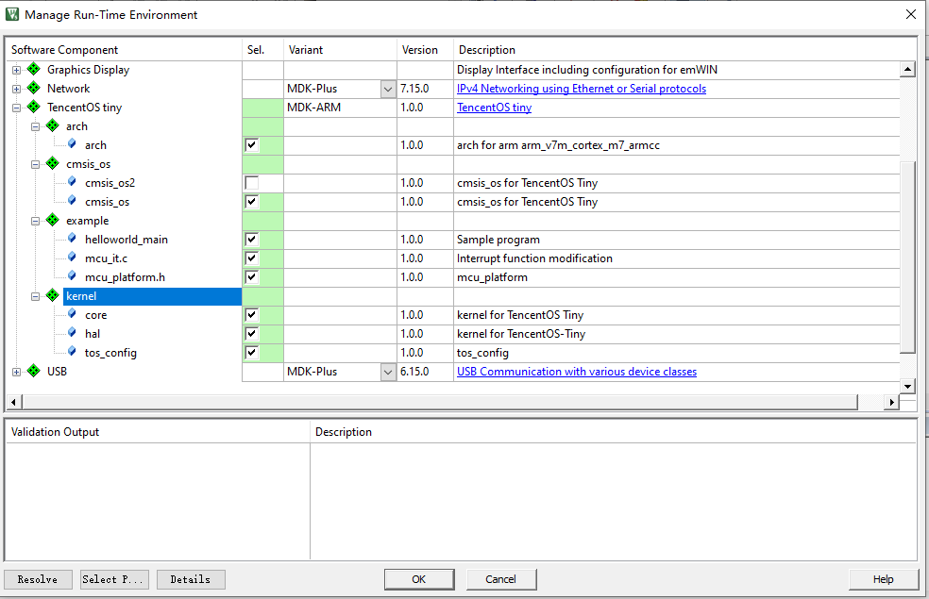
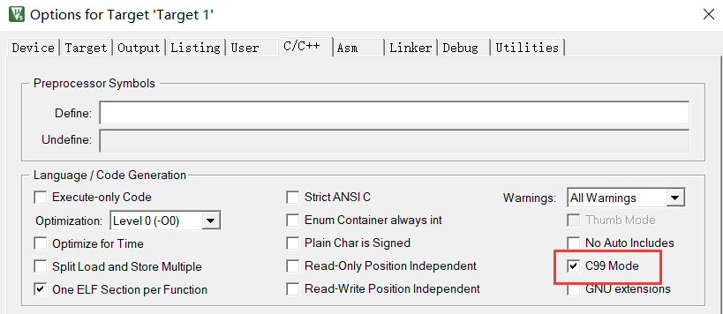
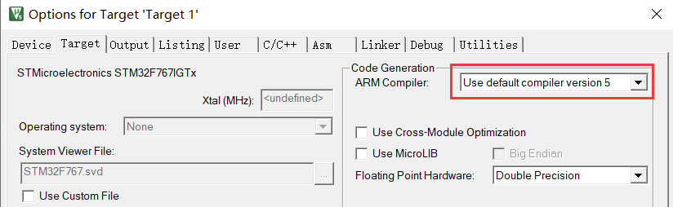
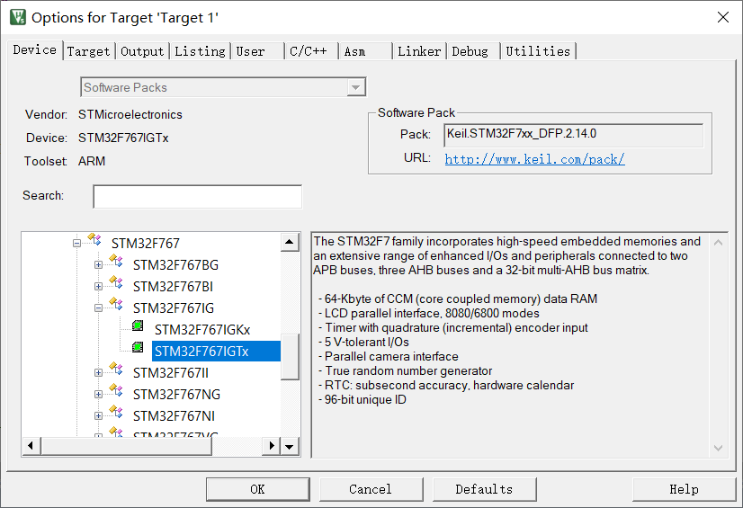
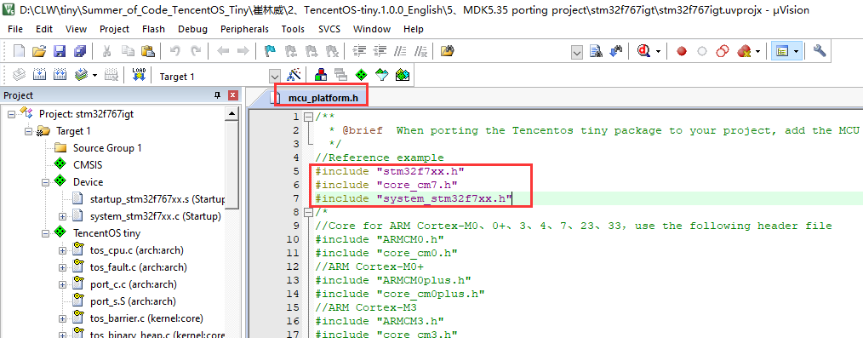
3. Vendor chip porting packages based on ARM cores

Slide 25
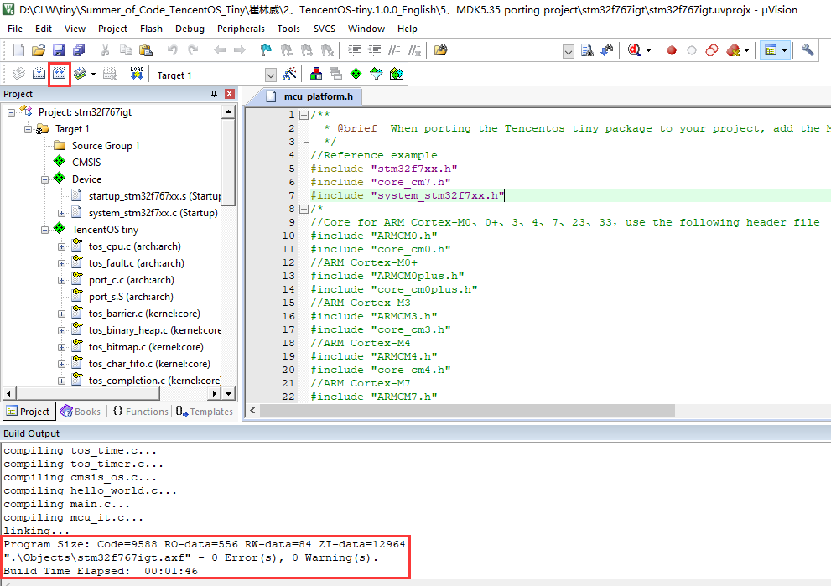
3. Vendor chip porting packages based on ARM cores

Slide 26
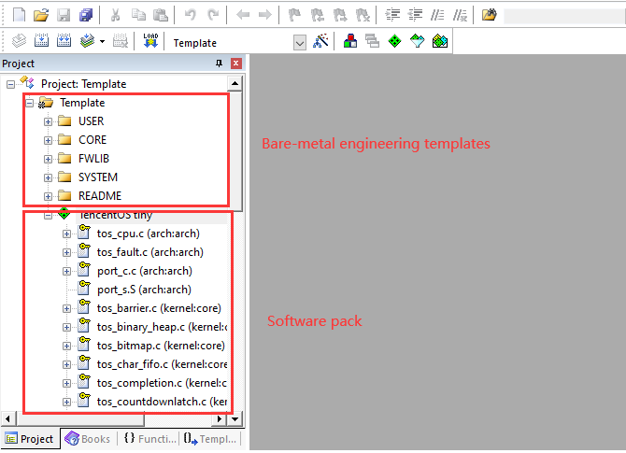
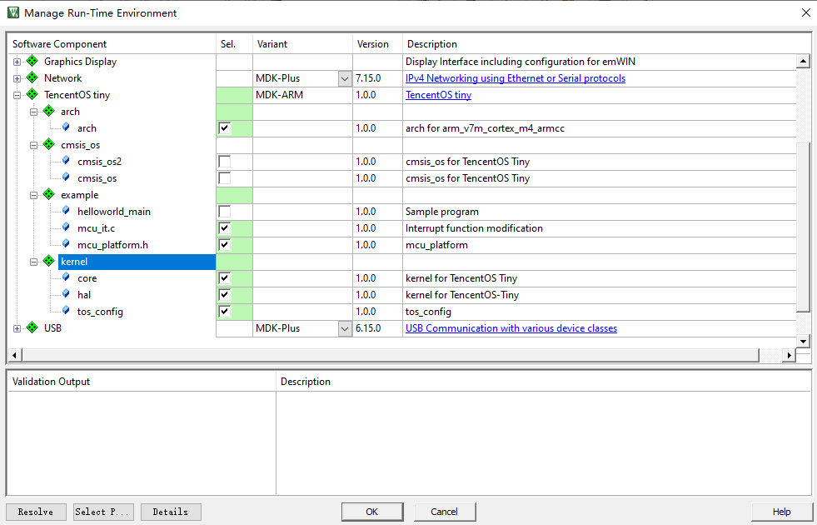
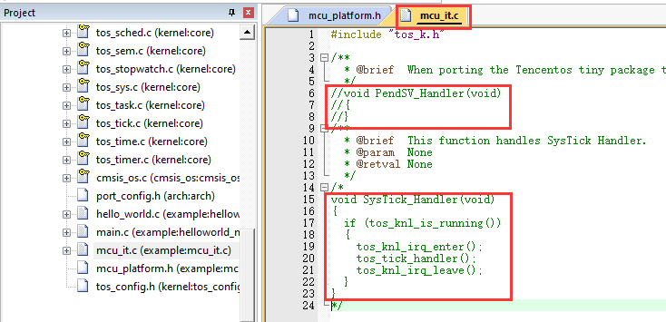
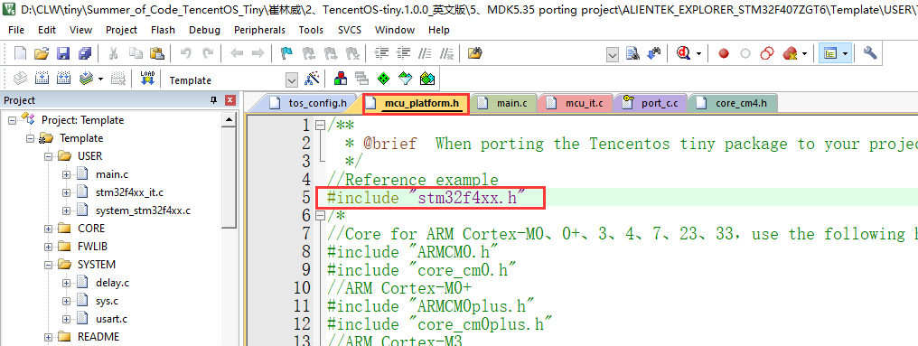
4. Microcontroller porting package based on ARM core

Slide 27
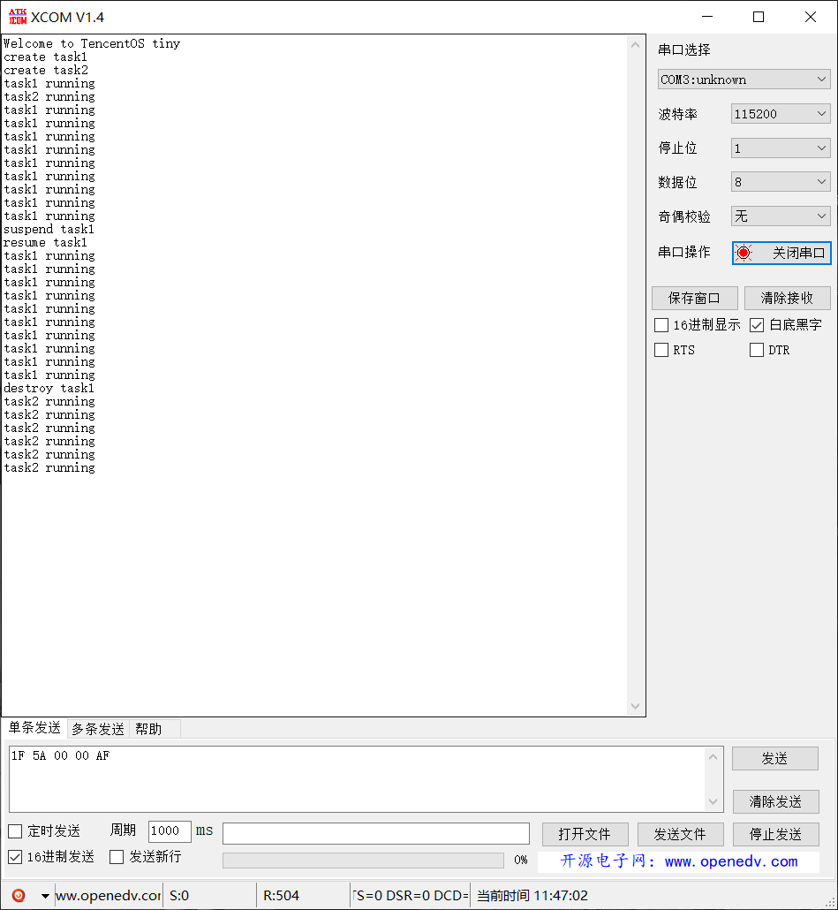
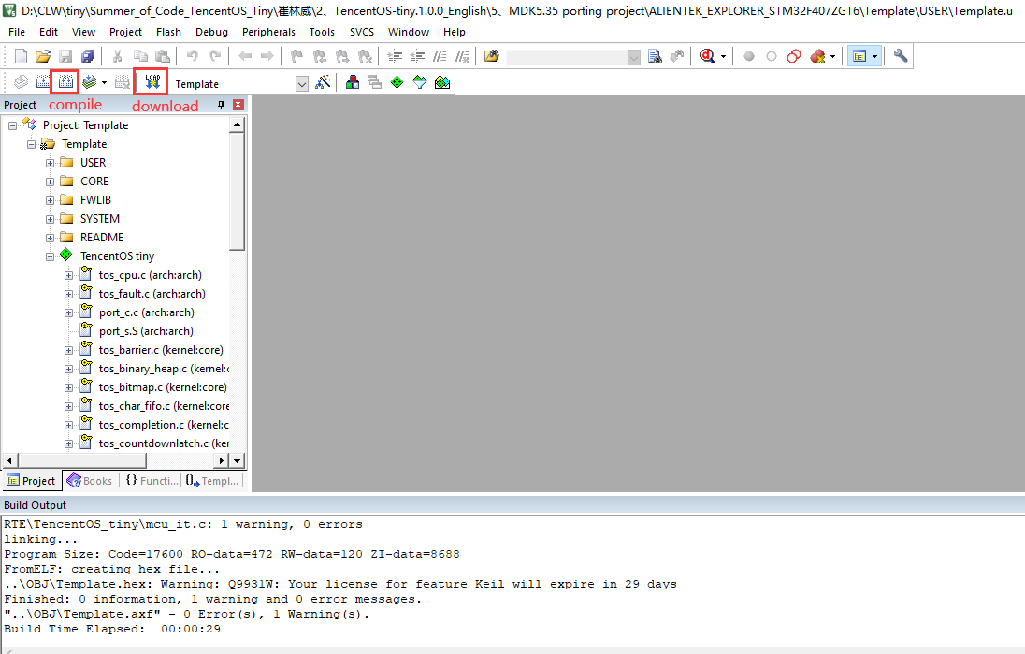
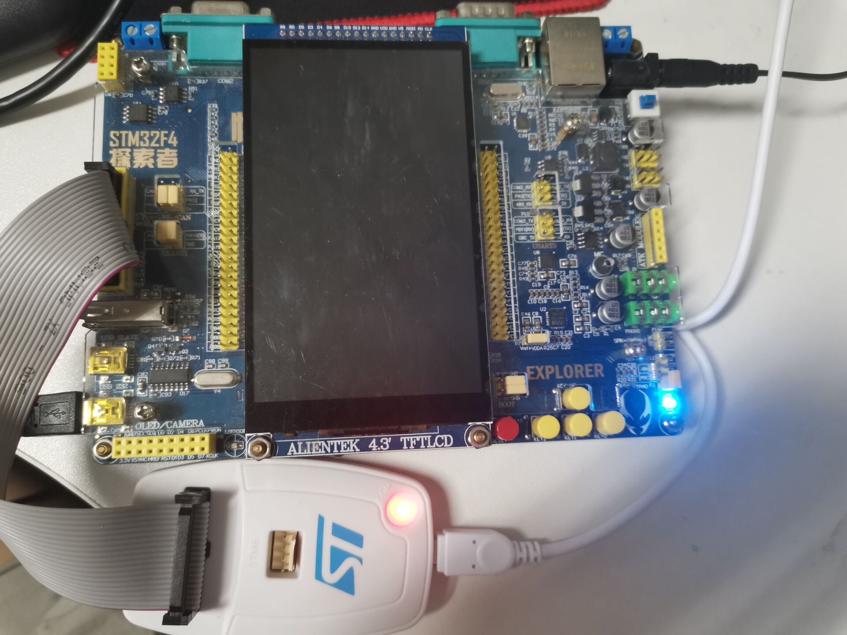
4. Microcontroller porting package based on ARM core

Slide 28

Summary and outlook

Slide 29

Summary and outlook
Functional features
User-friendly interface and kernel; adaptationDependency alerts, easy to extend;
result
Fast porting of Tencnet OS-tiny to different ARM cores, chips and microcontroller development boards
Outlook
Testing of chips with more cores and refinement of the software package.

Slide 30
Thank you for watching
date：2021/09/09

